Slide 1
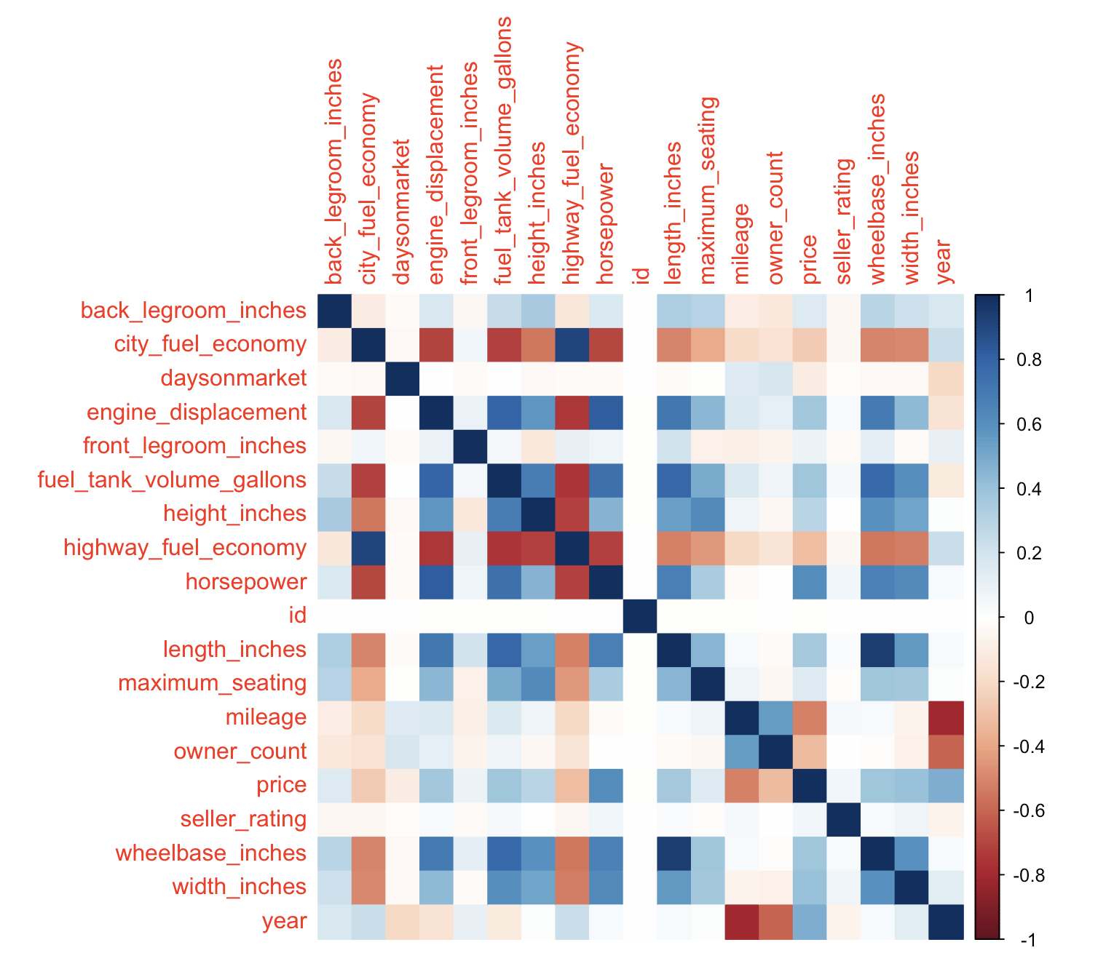
Kaggle Competition - Used Cars Price Prediction
APAN5200
Tina Lin (hl3732)
1.Exploratory Data Analysis (EDA)
2. Data Cleaning
3. Feature Selection
4.Model Selection
Data understanding
Visualizing the data (ggplot2)
Correlation Analysis
Remove all NAs → replace all NAs with mean or median
Only using numerical variables -> mainly numerical and some categorical
Hybrid Stepwise
Backwards Stepwise
Regression Tree
Multiple Regression
Tuned Random Forests
Ranger
XGBoost
Apply same data cleaning process on scoring dataset
12 submissions: RSME 10501 -> 2653
Self-reflection - Prioritize data cleaning process and understand the correlation
5.Results
(& do again?)

